Slide 1


GameSAT
Play to learn.

Slide 2


Ayush Dhumal
Graduation date: Fall 2021
Interests: Cloud, Blockchain, and Technology

Slide 3

Andris Docaj
MS student
Interests: Mathematics, Computer Science, Physics

Slide 4

Mostofa Adib Shakib
Adib
May 2021

Slide 5

Scott McFarlane
Senior graduating 2021
Interests: Computers and game design
Played the trumpet for 8 years

Slide 6

Shree Shrestha
Senior Computer Science Student
Interests:Computer Science, Mathematics and Electronics

Slide 7






Project Motivation _____________________________________
Preparation
Fun
4.4M Candidates

Slide 8

Project Motivation _____________________________________
equivocal
adj. – not easily understood or explained
click
Questions are unrealistic and more difficult than exam
Most current apps inspired by outdated GRE prep or Quizlet

Slide 9

Project Motivation _____________________________________
Verbal section of both GRE and SAT is abstract
Articles come from various field of study and seem unrelated
Indispensable for a student to possess a strong vocabulary to do well

Slide 10

Project Motivation _____________________________________
Games make learning fun, and require attention and focus
Games provide opportunity for feedback and practice
Research shows student reading below grade level, will read texts above their grade level if it is part of a game

Slide 11






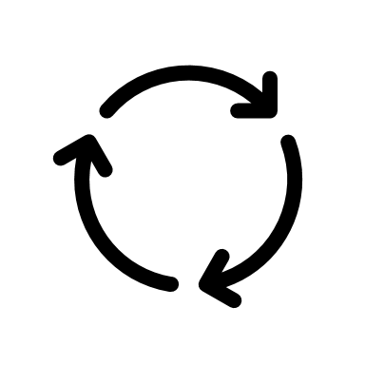

Expected Functionalities

Slide 12
Expected Functionalities
Restart button
Help button
Skip question
Mathematics questions
Training Mode
No point system
Missed questions will show up more frequently

Slide 13
Implementation
This game initially starts with 10 points
As per the player's response, 1 point is added for every correct response and 1 point is deducted for every incorrect response
After each response, the checkbox of correct option is turned green but if player has selected a wrong answer the selected answer's checkbox will turn red
Correct answer for each question is displayed after each response
For 5 consecutives correct responses, 1 bonus point will be added to the total score of the player
This game consists of 5 different levels
Whenever a player accumulates 10 points, the game is advanced to the next level with more challenging questions
A total score of 0 terminates the game with display message "Game Over"
A total score of 50 terminates the game with display message "Congratulations"

Slide 14
Technologies to be used
Java – This project will be coded using Java Programming language.
Android Studio
Windows
Linux
MacOS

Slide 15
References
1. https://crunchprep.com/beginners-guide-to-gre/introduction-to-gre
2. https://www.ets.org/s/gre/pdf/gre_volumes_by_country.pdf
3. https://newsroom.collegeboard.org/nearly-22-million-students-class-2020-took-sat-least-once#:~:text=9%2F9%2F2020-,Nearly%202.2%20Million%20Students%20in%20the%20Class%20of,The%20SAT%20At%20Least%20Once&text=New%20York%E2%80%94Nearly%202.2%20million,Assessments%20Program%20Results%20released%20today.
4. https://serc.carleton.edu/introgeo/games/whygames.html
5. https://news.stanford.edu/2013/03/01/games-education-tool-030113/
6. https://guides.library.utoronto.ca/c.php?g=448614&p=3505475

